Slide 1
The Regression Model; Analysis of Residuals

Slide 2
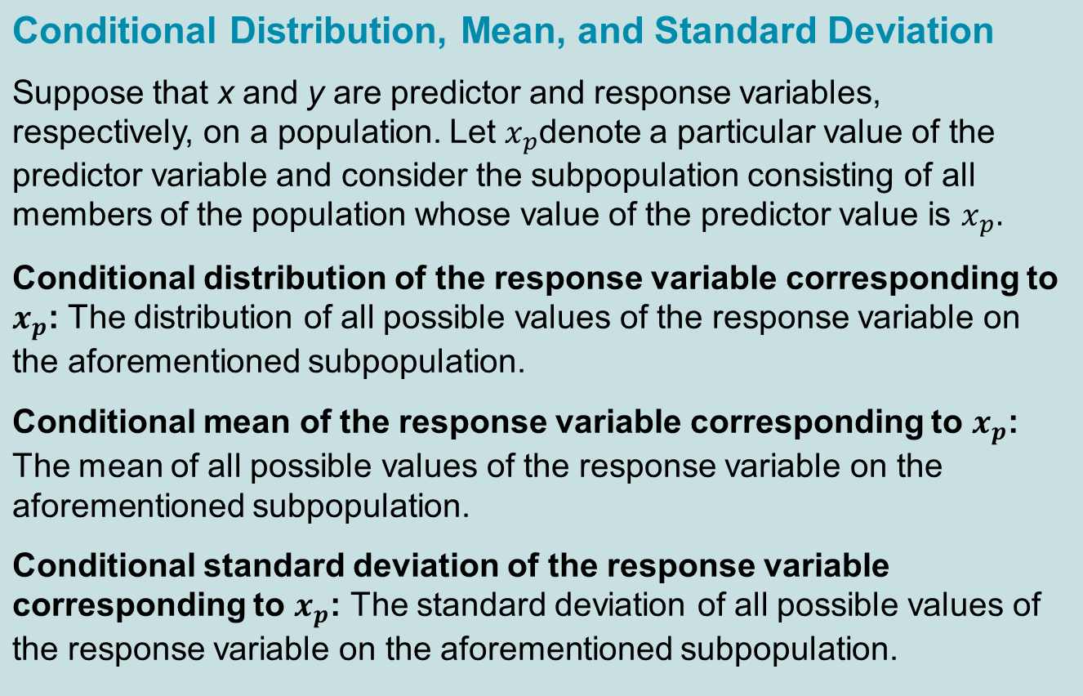
Definition 14.1

Slide 3
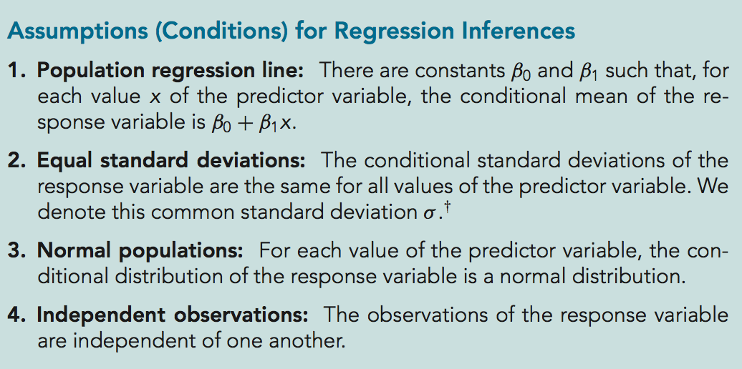
Key Fact 14.1

Slide 4
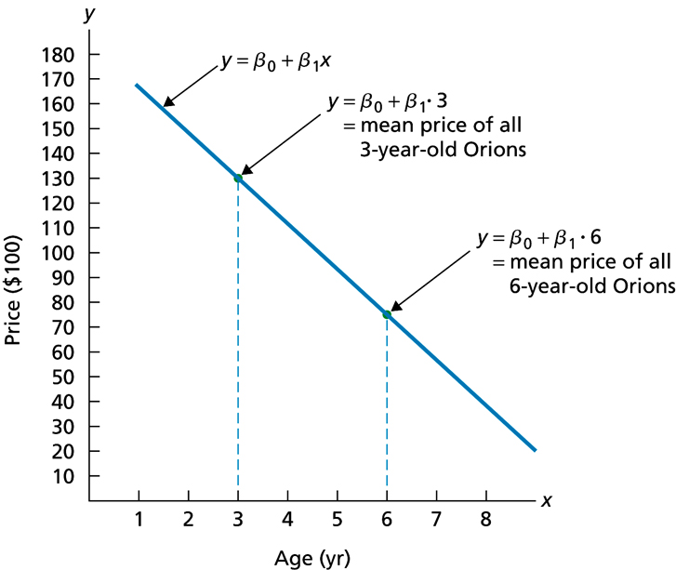
Figure 14.1
Population regression line

Slide 5
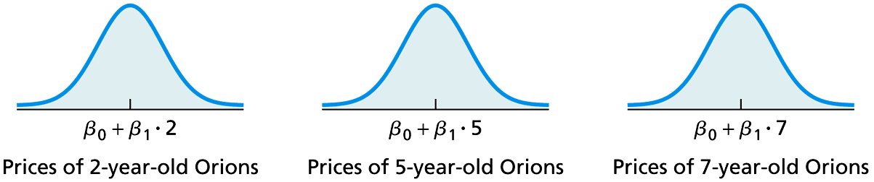
Figure 14.2
Price distributions for 2-, 5-, and 7-year-old Orions under Assumptions 2 and 3 (The means shown for the three normal distributions reflect Assumption 1)

Slide 6
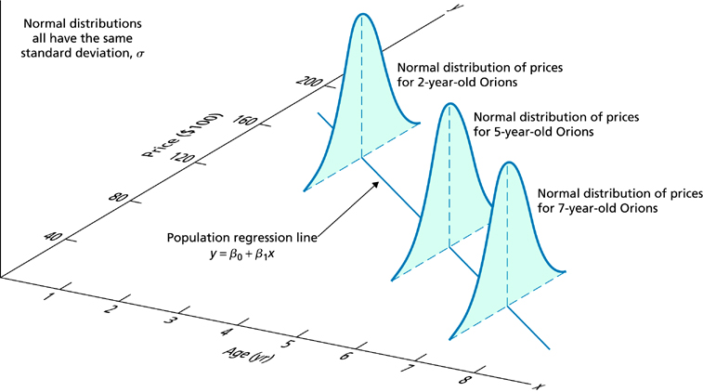
Figure 14.3
Graphical portrayal of Assumptions 1–3 for regression inferences pertaining to age and price of Orions

Slide 7
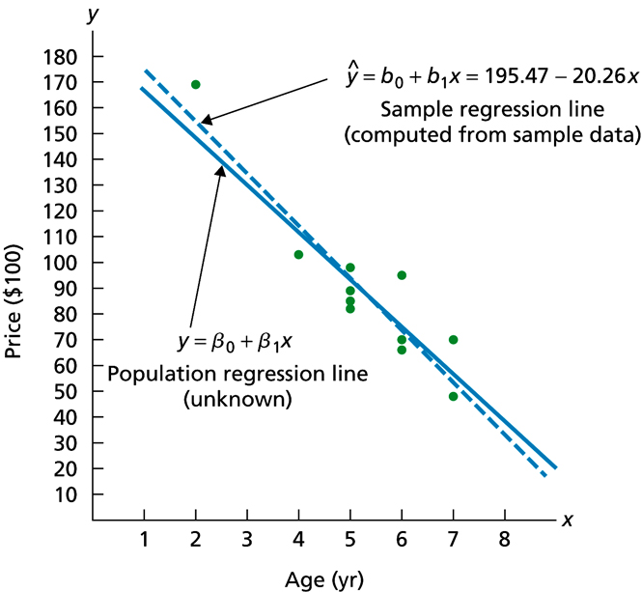
Figure 14.4
Population regression line and sample regression line for age and price of Orions

Slide 8
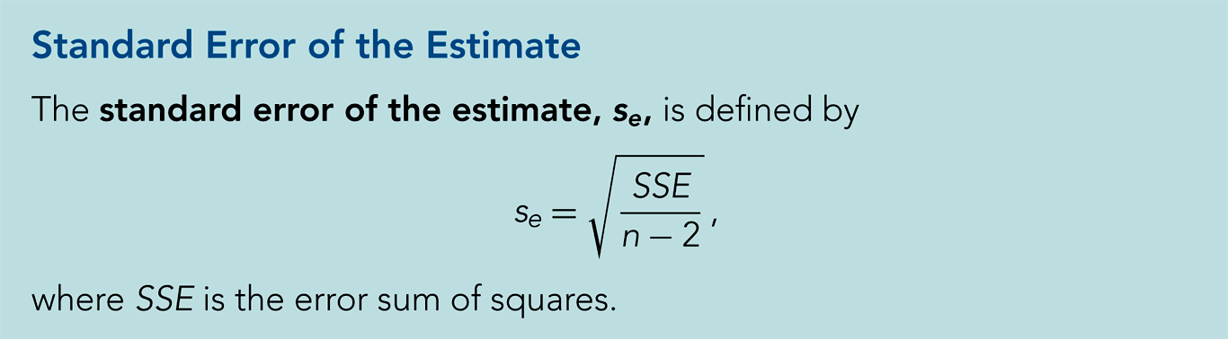
Definition 14.2

Slide 9
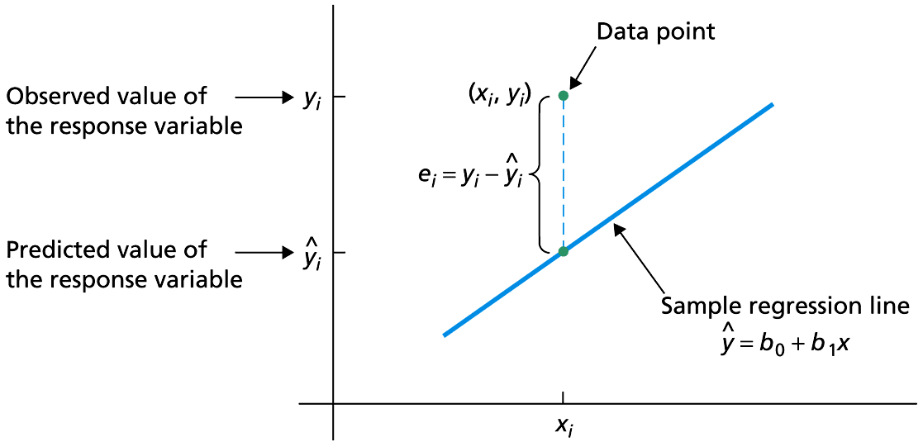
Figure 14.5
Residual of a data point

Slide 10
Key Fact 14.2
Residual Analysis for the Regression Model
If the assumptions for regression inferences are met, the following two conditions should hold:
A plot of the residuals against the observed values of the predictor variable should fall roughly in a horizontal band centered and symmetric about the x-axis.
A normal probably plot of the residuals should be roughly linear.
Failure of either of these two conditions casts doubt on the validity of one or more of the assumptions for regression inferences for the variables under consideration.

Slide 11
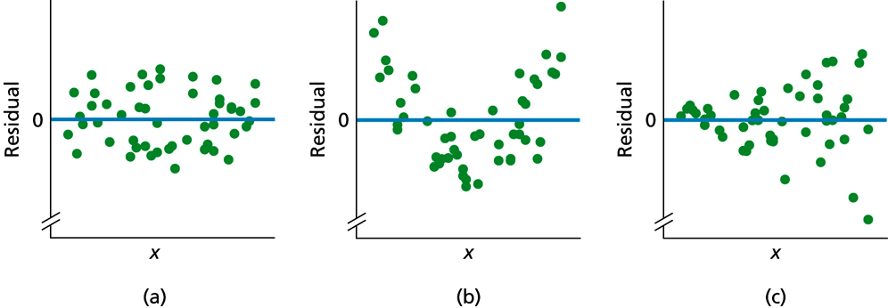
Figure 14.6
Residual plots suggesting (a) no violation of linearity or constant standard deviation, (b) violation of linearity, and (c) violation of constant standard deviation

Slide 12
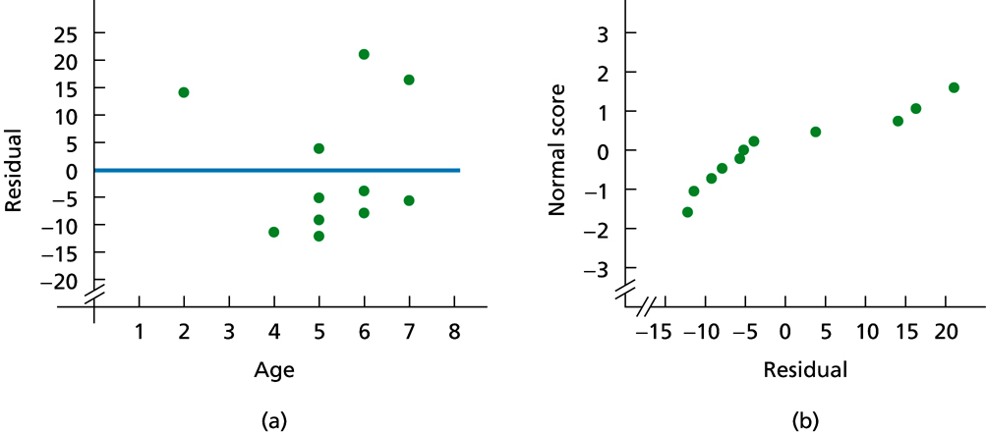
Figure 14.7
(a) Residual plot; (b) normal probability plot for residuals

Slide 13
Inferences for the Slope of the Population Regression Line

Slide 14
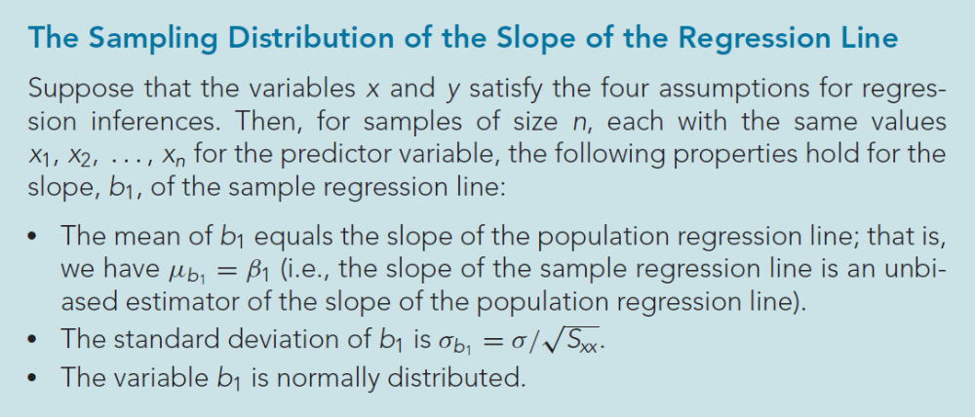
Key Fact 14.3

Slide 15
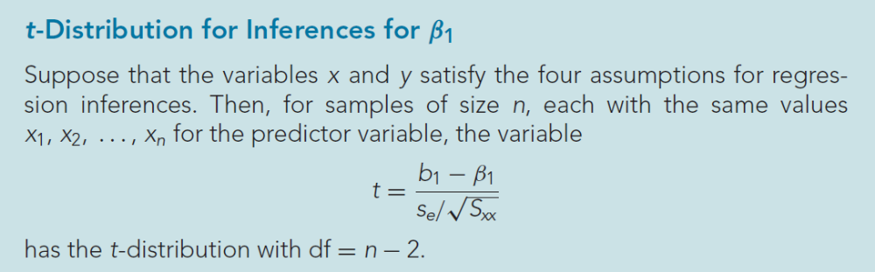
Key Fact 14.4

Slide 16
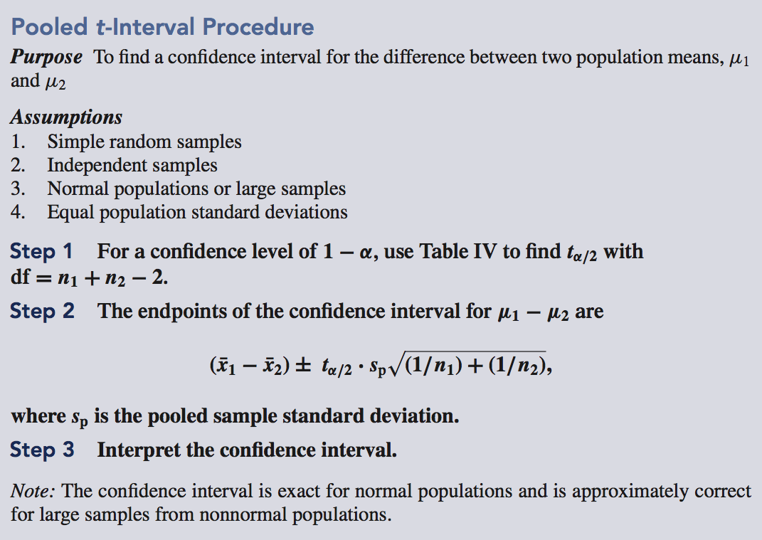
Procedure 14.1

Slide 17
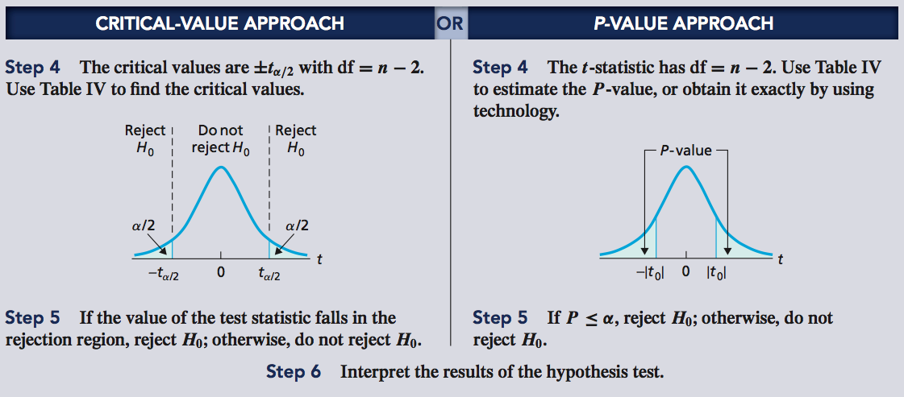
Procedure 14.1 (cont.)

Slide 18
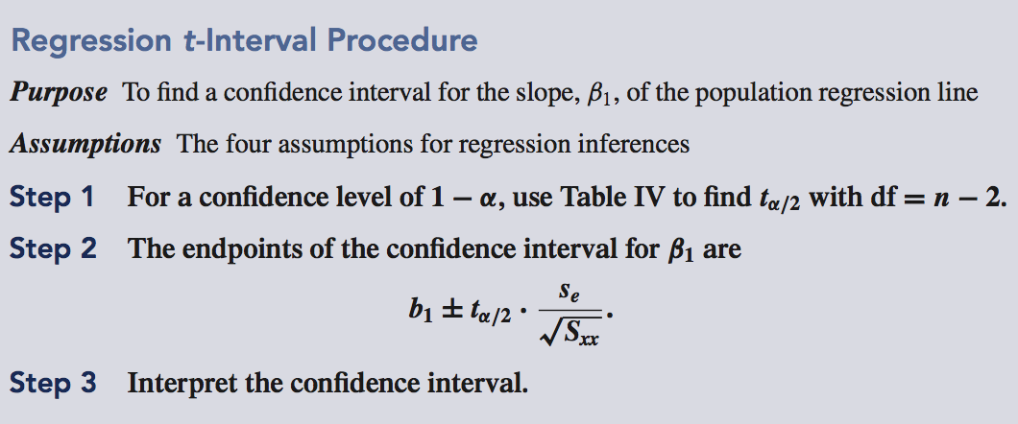
Procedure 14.2

Slide 19
Estimation and Prediction

Slide 20
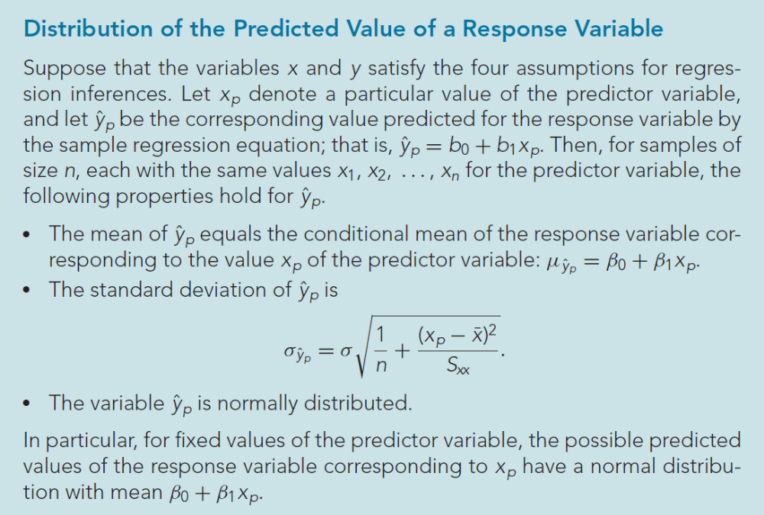
Key Fact 14.5

Slide 21
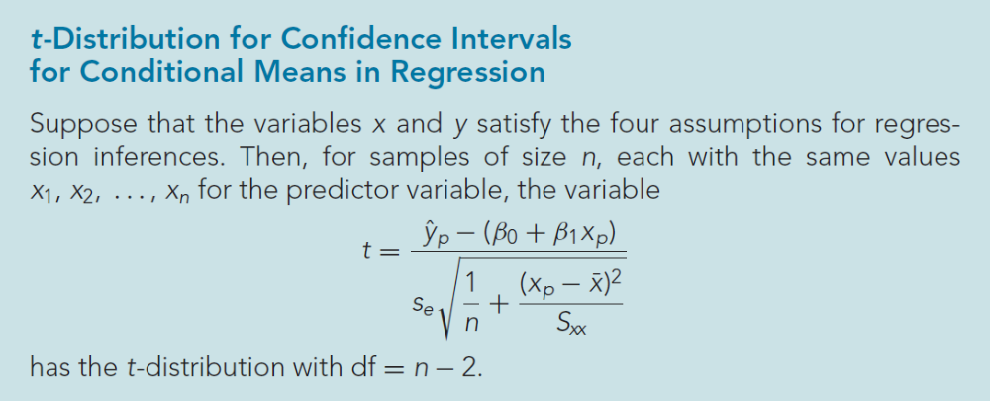
Key Fact 14.6

Slide 22
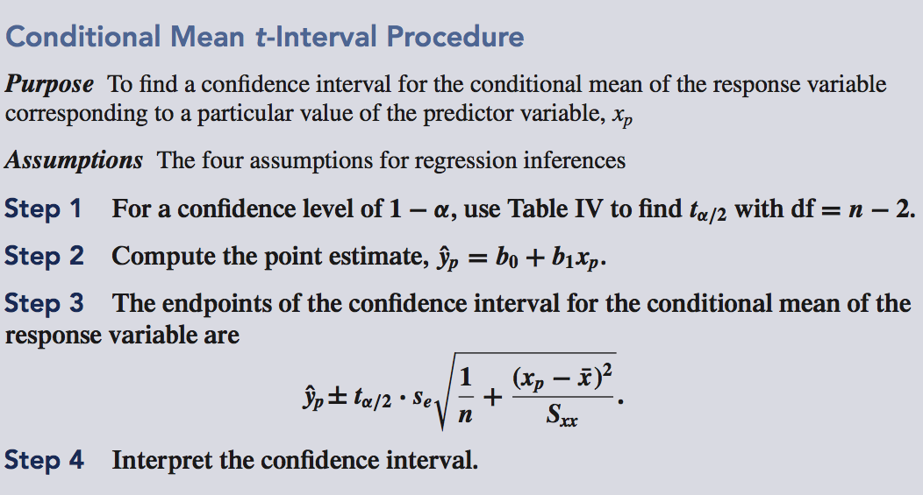
Procedure 14.3

Slide 23
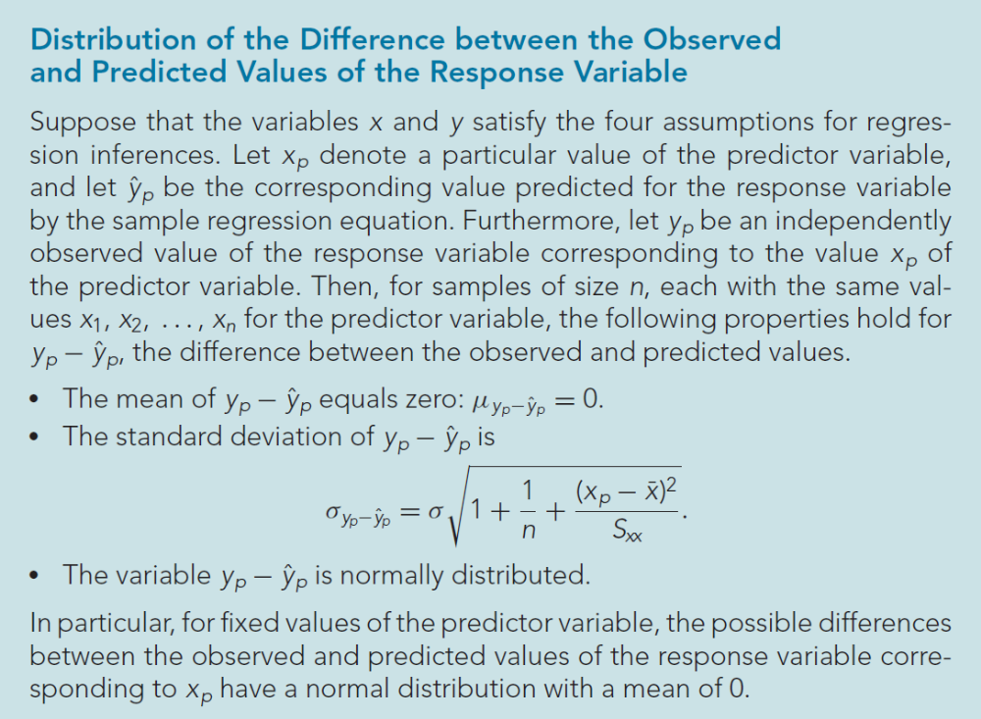
Key Fact 14.7

Slide 24
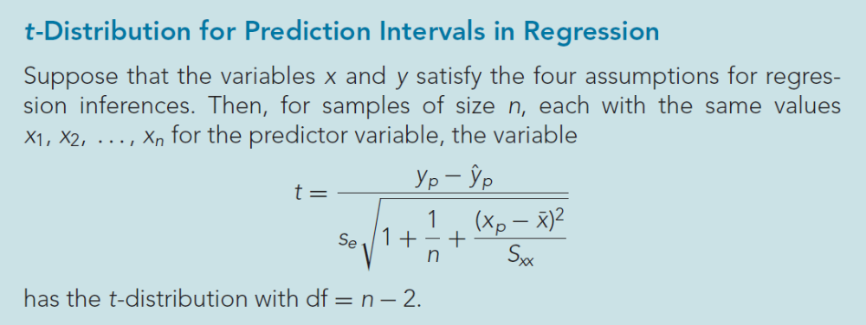
Key Fact 14.8

Slide 25
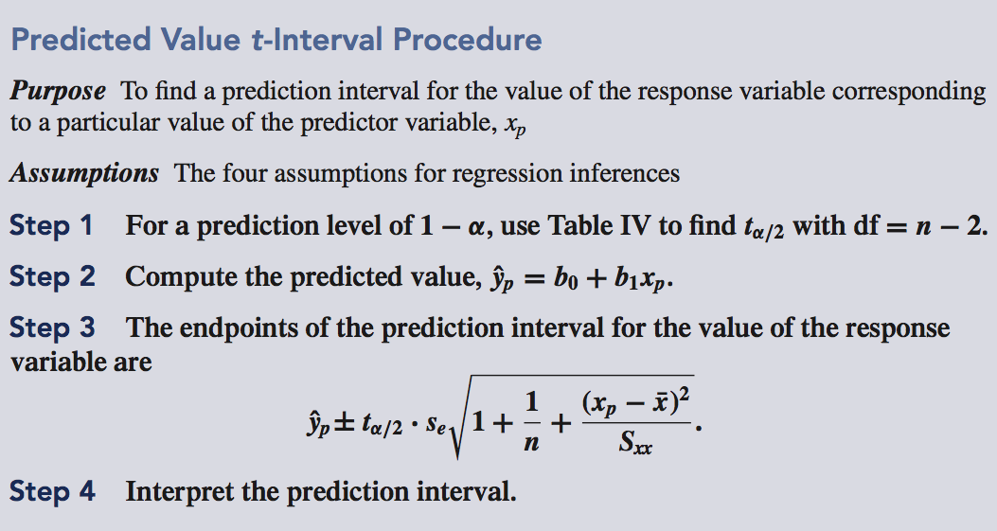
Procedure 14.4

Slide 26
Inferences in Correlation

Slide 27
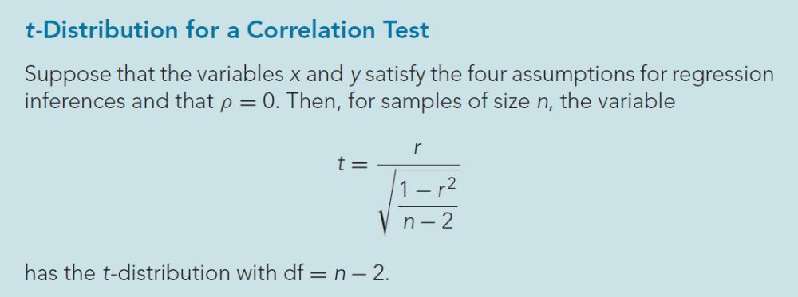
Key Fact 14.9

Slide 28
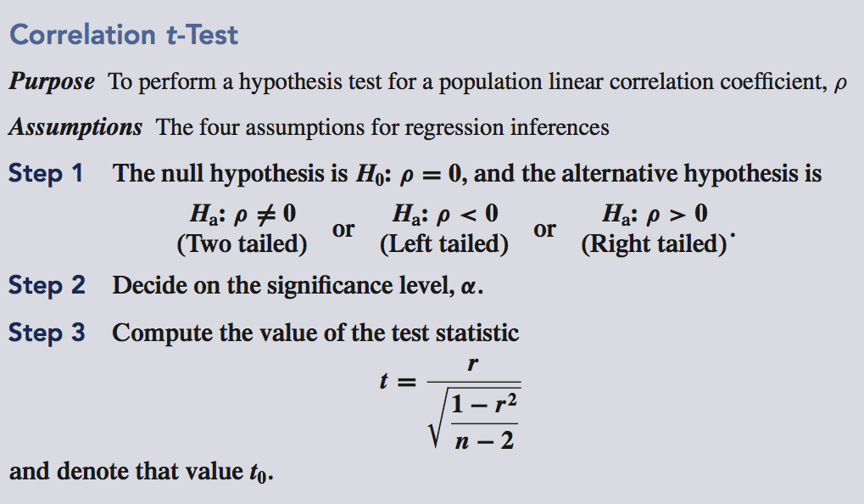
Procedure 14.5

Slide 29
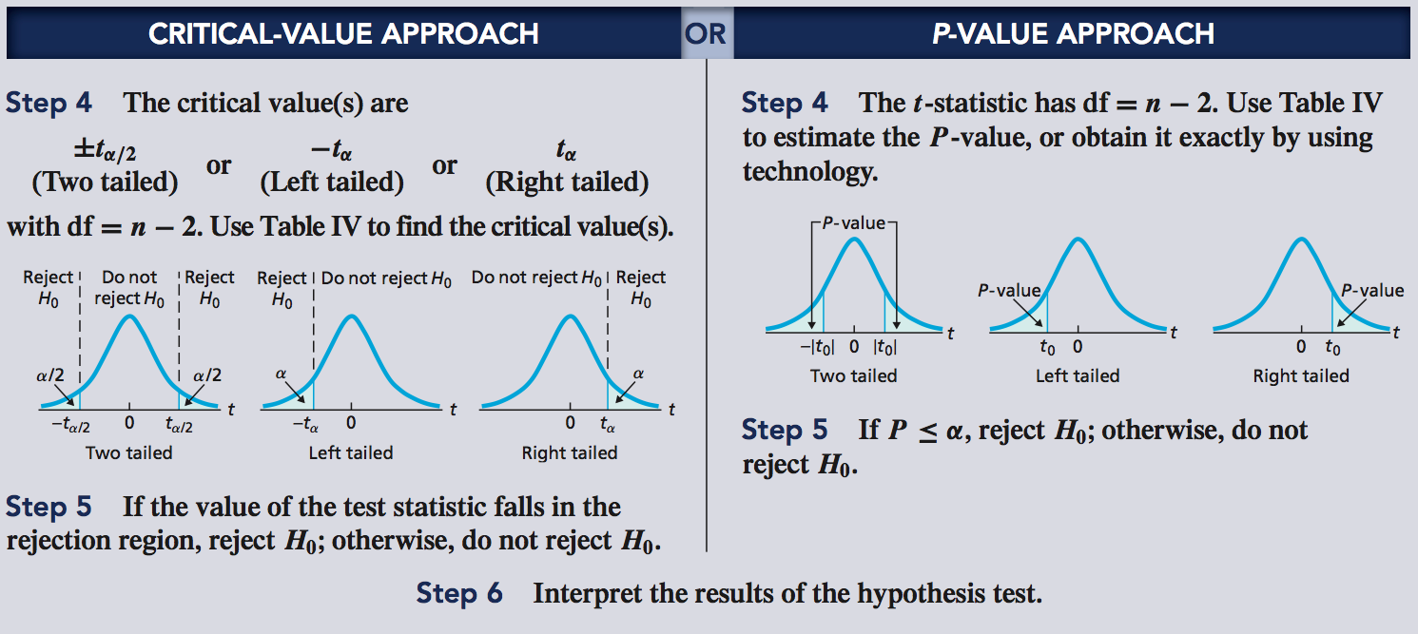
Procedure 14.5 (cont.)

